Slide 1
Project meeting
2019.2.22

Slide 2
Progress statement
The transmission and reception of lora with Raspberry pi 3 + SX1276 LoRa Module
Create your own gateways and applications via NTT(THE THINGS NETWORK)

Slide 3
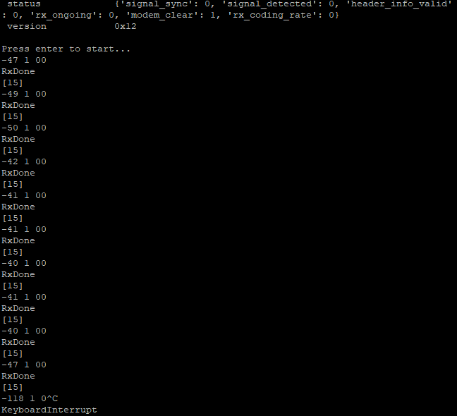
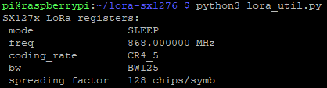
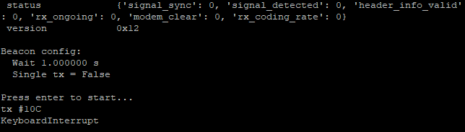
Data transmission and reception
continuous receive
Preset parameter
continuous transmission

Slide 4
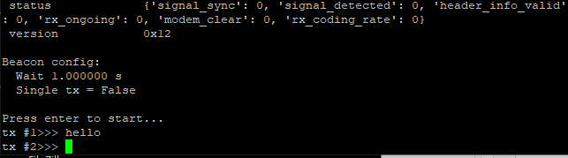
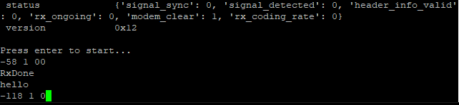
Data transmission and reception
Transfer
receive

Slide 5
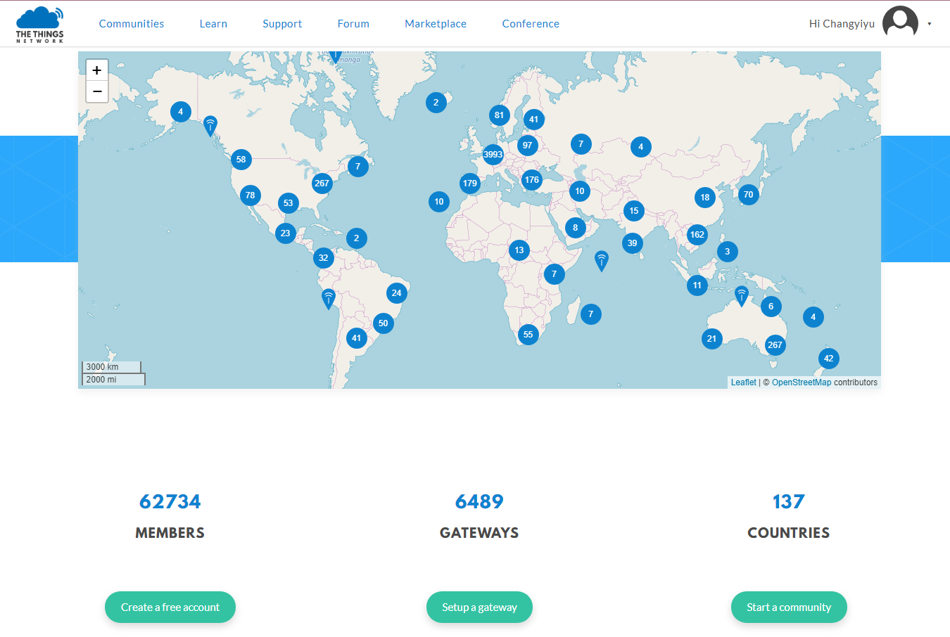
The Things Network

Slide 6
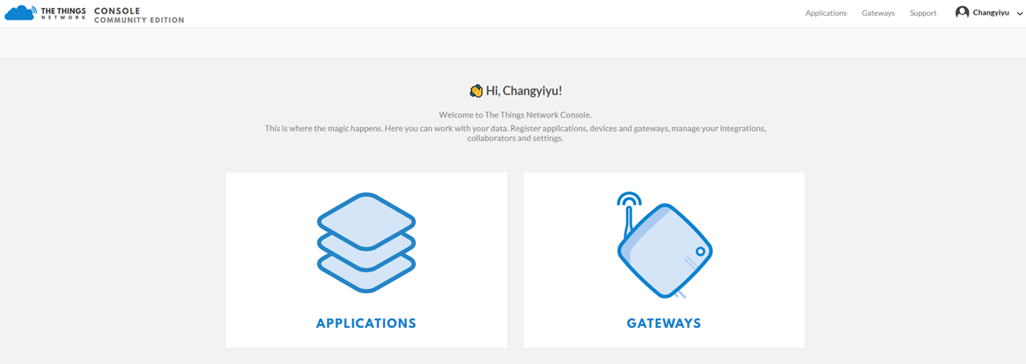
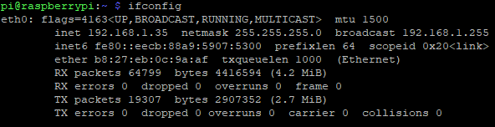
CONSOLE
Register a new gateway
Gateways EUI
Gateway connection testing

Slide 7
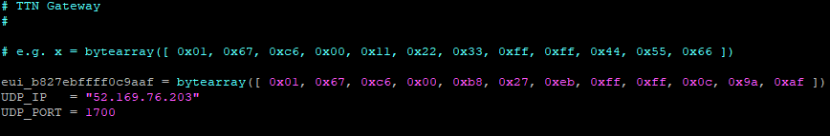
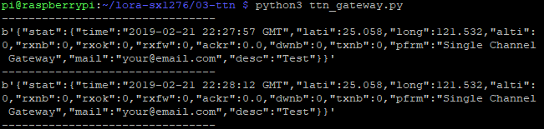
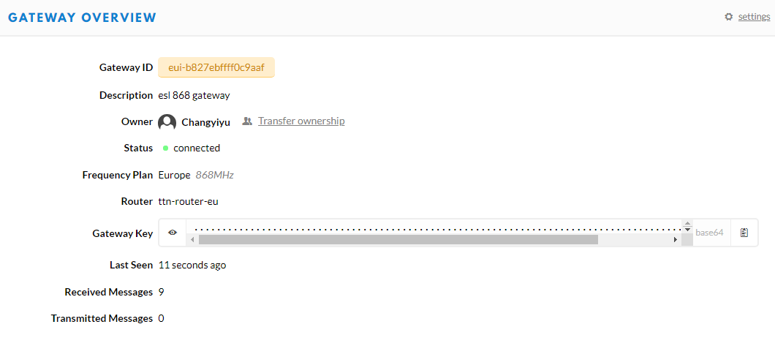
Gateway connection
Connection succesfull

Slide 8
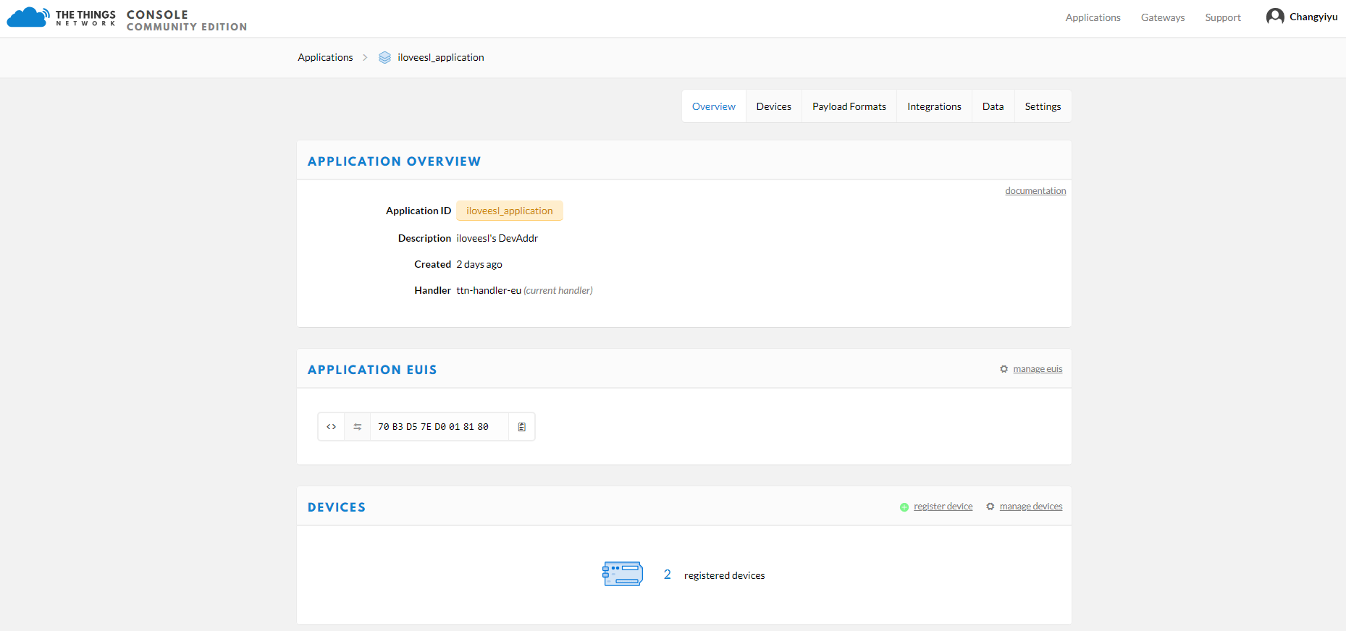

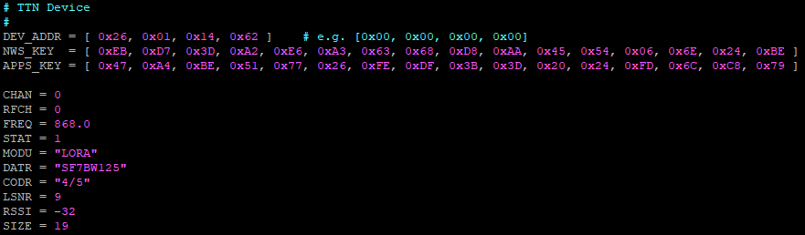

Slide 9
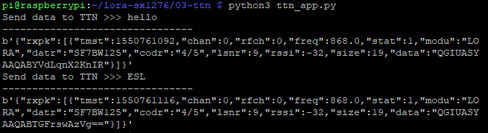
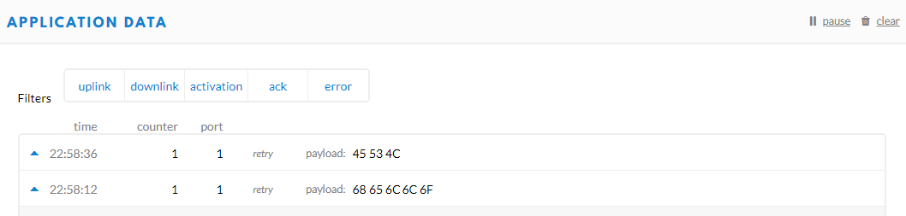
execution transfer
successfully transmitted

Slide 10
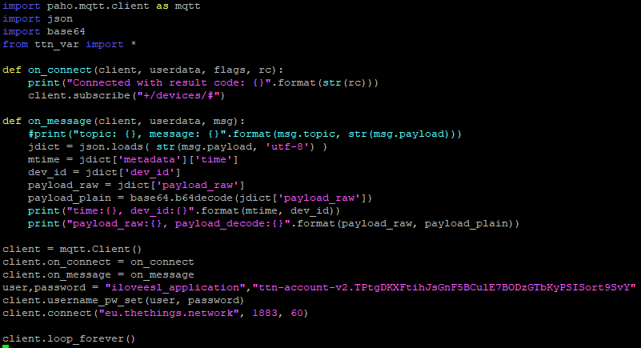
Subscribe to TTN by MQTT

Slide 11


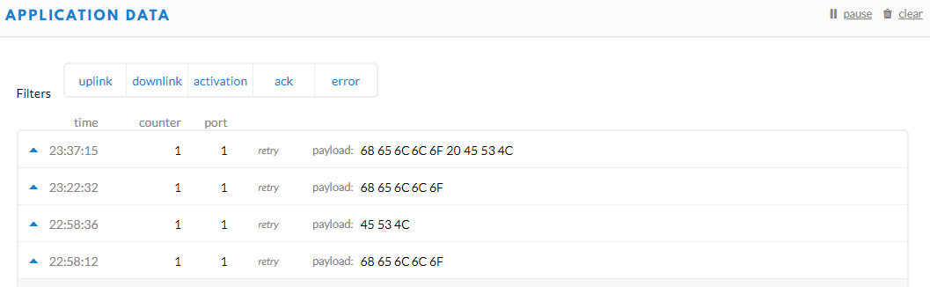
To perform a subscription on by MQTT terminal-1
MQTT transmitted on terminal-2
TTN’s APP information was subscribed by MQTT on terminal-1
TTN’s APP information

